Slide 1
UNIT 1
Financial System
Prepared by: Ms. Asma Anjum
Assistant Professor

Slide 2
Financial System
Deals with financial transactions and the exchange of money between savers, investors, lenders and borrowers.
It is a network of financial institutions, financial markets, financial instruments as financial services to facilitates the transfer of funds.
The level of economic growth largely depends upon and is facilitated by the state of financial system prevailing in the economy
Efficient financial system and sustainable economic growth are corollary
Seekers of Funds---------------------------------→Suppliers of Funds (mainly business ←-------------------------------------(mainly households)
firms and government)

Slide 3
Functions of Financial System
Provides payment system for exchange of Goods and Services
Provides the mechanism to pull the funds
Provides financial capital for long term capital formation
Facilitates investors to liquidate their investment alternatives
Provides avenues for managing risks
Takes care of both long-term and short-term needs
Supplies required financial capital to government
Provides price information to coordinate decentralized decision-making
Creates different investment opportunities
Helps in efficient allocation of financial resources

Slide 4
Indian Financial System
Phase 1: Upto 1951
Closed circle of industrial entrepreneurship
Semi-organised and narrow industrial securities market
Absence of participation by financial intermediaries
Reflected low per capita income, savings, national income and purchasing capacity Phase 2: from 1951 to mid 80s
Distribution of credit and finance
Public ownership of financial institutions
Fortification of institutional structure
Planned economic development
Protection of investors by constituting legislative codes
Participation of financial institution in management
Phase 3: from 1990 onwards
Variegated structure of development banks
Setting up LIC and UTI
Encouragement to new entrepreneurs and small enterprises
Development of backward regions
Private sector banks have far better managerial capability than public banks
Liquidity adjustment is influenced by Repo rate and Reverse Repo rate

Slide 5
FINANCIAL SYSTEM REFORMS

Slide 6
Narasimham Committee 1 (1991)
It was established to give reforms pertaining to the financial sector of India including the capital market and banking sector.
Some of its major recommendations have been mentioned below:
It recommended reducing the cash reserve ratio (CRR) to 10% and the statutory liquidity ratio (SLR) to 25% over the period of time.
It suggested fixing at least 10% of the credit for priority sector lending to marginal farmers, small businesses, cottage industries, etc.
In order to provide required independence to the banks for setting the interest rates themselves for the customers, it recommended de-regulating the interest rates.

Slide 7
Narasimham Committee 2 (1998)
Robust Banking System by merging major public sector banks to boost trade.
High Non-Performing Assets (NPAs) were a problem back in 1998, so the Committee recommended Narrow Banking Concept where the banks could put their funds in short-term and risk-free assets. The recommendations led to the Securitization and Reconstruction of Financial Assets and Enforcement of Security Interest Act, 2002.
RBI be the regulator but, they should not have ownership in any bank.
Proposed the government should increase the Capital Adequacy Ratio norms.
Foreign Exchange – The Committee recommended that the foreign exchange open position limits carry 100% risk weight. The Committee also proposed that the minimum start-up capital for foreign banks should be increased to $25 million from $10 million.

Slide 8
Reforms in the Banking Sector
Reduction in CRR and SLR has given banks more financial resources for lending to the agriculture, industry and other sectors of the economy.
The system of administered interest rate structure has been done away with and RBI no longer decides interest rates on deposits paid by the banks.
Allowing domestic and international private sector banks to open branches in India, for example, HDFC Bank, ICICI Bank, Bank of America, Citibank, American Express, etc.
Issues pertaining to non-performing assets were resolved through Lok adalats, civil courts, Tribunals, The Securitisation And Reconstruction of Financial Assets and the Enforcement of Security Interest (SARFAESI) Act.
The system of selective credit control that had increased the dominance of RBI was removed so that banks can provide greater freedom in giving credit to their customers.

Slide 9
Reforms in the Debt Market
The 1997 policy of the government that included automatic monetization of the fiscal deficit was removed resulting in the government borrowing money from the market through the auction of government securities.
Borrowing by the government occurs at market-determined interest rates which have made the government cautious about its fiscal deficits.
Introduction of treasury bills by the government for 91 days for ensuring liquidity and meeting short-term financial needs and for benchmarking.
To ensure transparency the government introduced a system of delivery versus payment settlement.

Slide 10
Reforms in the Foreign Exchange Market
Market-based exchange rates and the current account convertibility was adopted in 1993.
The government permitted the commercial banks to undertake operations in foreign exchange.
Participation of newer players allowed in rupee foreign currency swap market to undertake currency swap transactions subject to certain limitations.
Replacement of foreign exchange regulation act (FERA), 1973 was replaced by the foreign exchange management act (FEMA), 1999 for providing greater freedom to the exchange markets.
Trading in exchange-traded derivatives contracts was permitted for foreign institutional investors and non-resident Indians subject to certain regulations and limitations.

Slide 11
Impact of Various Reforms in the Financial Sector
It increased the resilience, stability and growth rate of the Indian economy from around 3.5 % to more than 6% per annum.
A resilient banking system helped the country deal with the Asian economic crisis of 1977-98 and the Global subprime crisis.
The emergence of private sector banks and foreign banks increased competition in the banking sector which has improved its efficiency and capability.
Better performance by stock exchanges of the country and adoption of international best practices.
Better budget management, fiscal deficit, and public debt condition have improved after the financial sector reforms.

Slide 12
Indian financial System at Present
Prodigious growth in terms of size, diversity, sophistication and complexity.
Continuous and high rate of inflation.
Diversification & innovation in financial institutions, instruments and services.
Richness, diversity, complexity and well-developed nature of IFS.
Demonetization act as liquidity shock, also largely declined the high-valued transaction, equitable distribution of income and increases the tax to GDP ratio.

Slide 13
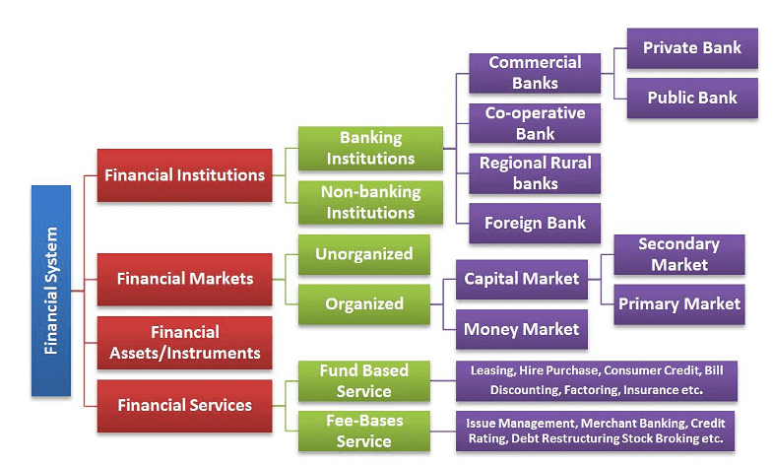
Structure of Indian Financial System

Slide 14
NEW Developments
in
Indian Financial System

Slide 15
Payment Banks
A New type of financial institution in India that was introduced in 2014 by RBI
Provide basic banking facility to people who are currently unbanked or underbanked.
Offer saving a/c, current a/c and mobile banking services
Example:
Airtel Payment Bank Joint venture Bharti Airtel and Kotak
Mahindra Bank
Paytm Payment Bank One97 Communication
India Post Payment Bank Dept of Post, Ministry of Communication
Jio Payment Bank Joint venture Reliance Industries and SBI

Slide 16
Goods and Service Tax
Value added tax levied on most goods and services sold for domestic consumption
.
Paid by consumers and remitted to the government by businesses
Taxed at a single rate
Simplifies the taxation system and reduces tax avoidance
India established dual GST structure in 2017
Implementation of GST system is a measure used to reduce inflation in long run.
Businesses with turnover above the 40 lakh or 20 lakh or 10 lakh as the case may be.

Slide 17
Monetary Policy
Monetary policy is adopted by the monetary authority of a country that controls either the interest rate payable on very short-term borrowing or the money supply.
Policy often targets inflation or interest rate to ensure price stability.
Instruments of monetary policy are:
Open Market Operations: buying & selling of securities.
Cash Reserve Ratio: commercial bank deposit a required amount to RBI as reserve.
Statutory Liquidity Ratio: Commercial bank maintain a certain quantity of liquid asset.
Bank Rate Policy: Repo rate and Reverse Repo rate.
Credit Ceiling: RBI levied certain limit to commercial bank on special sector.

Slide 18
Insolvency & Bankruptcy Code
Provides time-bound process for resolving insolvency in companies and among individuals.
Consolidated all laws related to and bankruptcy to tackle NPA.
Protect interest of stakeholders.
Revive the company in time-bound manner.
Promote entrepreneurship.
Set up Insolvency and Bankruptcy Board of India.
Covers all individuals, companies, LLPs and Partnership firms.
Adjudicating authority: NCLT & DRT

Slide 19
Acts related to Financial Sector Regulations
The Banking Regulation Act, 1949
The Securities (Regulations) Act, 1956
Securities and Exchange Board Act, 1992
The Depositories Act, 1996
The Foreign Exchange Management Act, 1999
Insurance Regulatory and Development Authority of India Act, 1999
The Competition Act, 2002
Securitization and Reconstruction of Financial Assets and Enforcement of Security Interest Act, 2002
Prevention of Money Laundering Act, 2002
The Micro, Small and Medium Enterprises Act, 2006
Payment and Settlement Systems Act, 2007
Issue of capital and Disclosure Requirements Regulations Act, 2009
The Companies Act, 2013
The Pension Fund Regulatory and Development Authority Act, 2013

Slide 20
Regulatory Institutions in India
RBI: Reserve Bank of India
SEBI: Securities & Exchange Board of India
IRDA: Insurance Regulatory and Development Authority
PFRDA: Pension Fund Regulatory and Development Authority

Slide 21
RBI: Reserve Bank of India
The Reserve Bank of India was established on April 1, 1935 in accordance with the provisions of the Reserve Bank of India Act, 1934.
The Central Office of the Reserve Bank was initially established in Kolkata but was permanently moved to Mumbai in 1937.
The Central Office is where the Governor sits and where policies are formulated.
Though originally privately owned, since Nationalisation in 1949, the Reserve Bank is fully owned by the Government of India.
The primary objective is to undertake consolidated supervision of the financial sector comprising Scheduled Commercial and Co-operative Banks, All India Financial Institutions, Local Area Banks, Small Finance Banks, Payments Banks, Credit Information Companies, Non-Banking Finance Companies and Primary Dealers.

Slide 22
Functions of RBI
Act as currency authority
Banker, Agent and financial advisor to Government
Bankers to the bank
Custodian to foreign exchange reserves
Lender of the last resort
Banks to Central clearance, settlement and transfer
Controller of credit
Supervisory functions
Promotional role
Regulation & Promotion of Payment System
Promotor of Financial System & Economic Development

Slide 23
SEBI: Securities and Exchange Board of India
The Securities and Exchange Board of India was established on April 12, 1988 but became statutory and powerful since from 1992 in accordance with the provisions of the Securities and Exchange Board of India Act, 1992.
The SEBI is managed by its members, which consists of
1. The chairman is nominated by the Union Government of India.
2. Two members, i.e., Officers from the Union Finance Ministry.
3. One member from the Reserve Bank of India.
4. The remaining five members are nominated by the Union Government of India, out of them at least three shall be whole-time members.
After the amendment of 1999, collective investment schemes were brought under SEBI except Nidhis, Chit Funds and Cooperatives.

Slide 24
Functions of SEBI
Protective Functions
a. Check price rigging
b. prohibit insider trading
c. prohibit fraudulent and unfair trade practices
d. undertake steps to educate investors
e. promote fair practices and code of conduct
2. Developmental functions
a. training of intermediaries
b. Promote activities of stock exchange by adopting flexible approach
3. Regulatory Functions
a. frame rules and regulations and code of conduct to regulate intermediaries
b. restrict private placement
c. regulates and registers stock brokers, sub-brokers, share transfer agents, trustees, merchant bankers, etc.
d. Register and regulates the working of mutual funds
e. Regulates takeovers of companies
f. Conduct inquiries and audit of stock exchanges

Slide 25
IRDA: Insurance Regulatory & Development Authority
Constituted as autonomous body to regulate and develop the business of insurance and reinsurance in India.
The IRDA Act 1999 enacted by Parliament to provide an authority to protect the interest of holders of insurance policies to regulate, promote and ensure orderly growth of the insurance industry.
The Key objectives of IRDA Act are
protect interest and secure fair treatment to policyholders
bring speedy and orderly growth of insurance industry
set, promote, monitor and enforce high standards of integrity
Ensure speedy settlement of genuine claims to prevent insurance frauds
promote fairness & transparency and orderly conduct in financial market
Take actions where standards are inadequate & inefficiently enforced

Slide 26
Powers & Duties of IRDA
Power to issue certificate to applicant in respect to registration, renewal or modification in insurance business
Duty to protect the interest of the policy holders in matter concerning assigning of policy, nomination by policyholder, insurable interest, settlement of claim, surrender value and other terms and conditions
To make insurance as standard profession IRDA specifies requisite qualification , code of conduct and practical training
Promote efficiency in conduct of insurance businesses
Promotes and regulates organisations connected with insurance and reinsurance
Bring out transparency in working of insurance sector
Controls and regulates rates, advantages, terms and conditions offered by insurers in respect of general insurance
Specifies the form and manner in which books of accounts shall be maintains and statements of accounts rendered by insurers
Apex body to adjudicate disputes between insurers and intermediaries
Supervising the functioning of Tariff Advisory Committee
Specifies the percentage of premium income of the insurer to finance scheme
Determine the percentage of life insurance and general insurance business undertaken by insurer in rural and urban areas

Slide 27
PFRDA: Pension fund Regulatory and Development Authority
The Pension Fund Regulatory & Development Authority Act was passed on 19th September, 2013 and the same was notified on 1st February, 2014.
Regulates NPS, subscribed by employees of Govt. of India, State Governments and by employees of private institutions/organizations & unorganized sectors.
The objective of PFRDA is to promote old-age income security by establishing, developing and regulating pension funds to protect the interests of the subscribers of pension fund and for matters connected therewith or incidental thereto.

Slide 28
Functions of PFRDA
Undertake steps for educating subscribers and the general public on issues relating to pension, retirement savings and related issues and training of intermediaries.
Provides pension schemes not regulated by any other enactment;
Protecting the interests of subscribers of NPS and such other schemes as approved by the authority from time to time.
Approving the schemes, and laying down norms of investment guidelines under such schemes;
Registering and regulating intermediaries- NPS Trust, Points of Presence, Central Record keeping Agency, Trustee Bank, Pension Funds, Custodian for time bound service to subscribers.
Ensuring that the intermediation and other operational costs are economical and reasonable;
Making existing grievance redressal process robust & time bound.
Adjudication of disputes between intermediaries and between intermediaries and subscribers.

Slide 29
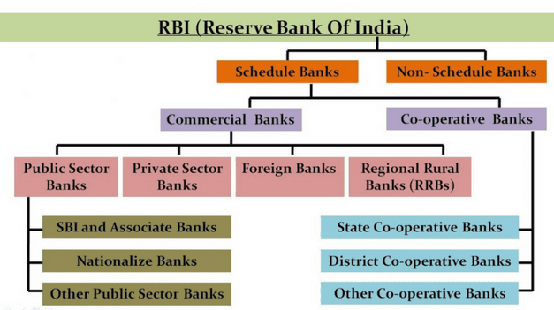
Depository Institutions

Slide 30
Classification of Bank
Scheduled Bank: Banks included in the Second Schedule of Reserve Bank of India Act, 1934, i.e., needs to satisfy three conditions
Must have paid up capital and reserve of an aggregate value of at least Rs. 5 lakhs
Must satisfy the Reserve bank that its affairs are not conducted in a manner detrimental to the interest of its depositors
Must be a corporation or co-operative society and not a partnership or single owner firm
It is categorized further into : Commercial Banks & Cooperative Banks
Non-Scheduled Bank: Banks not figured under Second Schedule of RBI Act 1934. These banks are under the Statutory Cash Reserve requirement.

Slide 31
Commercial Banks
Commercial bank is a profit based financial institution that grant loans, accepts deposits and offer other financial services such as overdraft facilities and electronic transfer of funds.
As per Indian Banking Company Act 1949, “A banking company means any company which transact the business of banking. Banking means accepting for the purpose of lending of investment of deposits of money from the public, payable on demand or other wise and withdraw able by cheque, draft or otherwise.”
Commercial banks are the financial institutions which accepts demand deposits from the general public, transfer funds from the bank to another and earn profit.

Slide 32
Functions of Commercial Banks
Primary Functions
Accepting Deposits
Lending Money
Overdraft
Cash Credit
Loans & Advances
Discounting of Bills of Exchange
Secondary Functions
Agency Functions
Collecting cheques
Collecting Income
Paying Expenses
Administration of wills and trusteeship
Representation and correspondence
Exchange of currency
Bullion Trading

Slide 33
2. General Utility Functions
Providing Locker Facilities
Issuing Traveler’s Checks
Dealing in Foreign Exchange
Transferring Funds
Acting as a Referee
Issuing Letter of Credit
Acting as Underwriters and Insurance Brokers
Acting as Information Banks
Issuing of Gift cheques
3. Other Functions:
Creating Money
Electronic Banking
Merchant Banking
ATM
Credit Cards

Slide 34
Role of Commercial Banks in Financial system
Mobilizing Saving for Capital Formation
Financing Industry & Agriculture
Financing Consumer Activities
Microfinance
Financing Employment Generating Activities
Help in Monetary Policy
Financing Trade

Slide 35
Indian Banking system
Phase I - (1786-1969)
Initial phase of banking in India when many small banks were set up
Phase II - (1969-1991)
Nationalization, Regularisation and Growth
Phase III – (1991 onwards)
Liberalisation and its aftermath

Slide 36
Recent Trends in Banking
Electronic Payment Services: E-cheques
Real Time Gross Settlement (RTGS)
Electronic Funds Transfers (EFT)
Electronic Clearing Services (ECS)
Automatic Teller Machine (ATM)
Point of Sale Terminal
Tele Banking
Electronic Data Interchange (EDI)

Slide 37
Challenges faced by Commercial Banks
Asset Quality
Capital Adequacy:
Balance Sheet management:
Unhedged forex exposure:
Employee and technology:
Customer retention:
Increased competition:

Slide 38
Non-Performing Asset
When it ceases to generate income for the bank
Credit in respect of which interest or instalment of principal has remained “past due” for a specific period of time i.e 2 quarters which id changes to 90 days from 31 March 2004
Agricultural Loan
For Short-duration Crops(lesser than 1 year): Due for 2 crop season
For Long-duration Crops(greater than 1 year): Due for 1 crop season
Assets Classification:
Standard Assets
Sub-standard Assets
Doubtful Assets
Loss Assets

Slide 39
Effect of NPAs
Burden on lenders
Non-Payment of interest
Reduces cash-flow
Disrupt budgets and earnings
Trends of NPA
PSUs shows decline in GNPAs from 14.1% in 2018 to 5% in 2023
NNPAs is just 1%
Private Sector banks also shows decline from 6.3% in 2018 to 2.3% in 2023
NNPAs is just 0.6%

Slide 40
BASEL
In 1973 BASEL committee on banking supervision was established by central bank governors of G10 members to follow the breakdown of Bretton Wood System on managed exchange rates.
Objectives:
Setting minimum standards for regulation and supervision of bank
Approaches and techniques to promote common understanding
Sharing supervisory issues
Improve cross-border cooperation
Exchanging information on development of banking sector and financial markets
Enhance financial stability

Slide 41
BASEL I
International Convergence of Capital Measurement and Capital Standards
Four Pillars: Constituents of capital
Risk weighting system
Target Standard Ratio
Transitional and Implementation arrangements
-----------------------------------------------
BASEL II
A revised Framework on Basel I Three Pillars: Minimum Capital Requirement
Supervisory Review process
Market Discipline

Slide 42
BASEL III
Banking regulation, supervision and risk management of the banking sector
Major changes:
Better capital quality
Capital conservation buffer
Countercyclical buffer
Minimum common equity and Tier 1 capital requirement
Leverage ratio
Liquidity Ratio
Systemically important financial institutions

Slide 43
Risk Management
Banking risk management is the process of a bank identifying, evaluating, and taking steps to mitigate the chance of something bad happening from its operational or investment decisions.
Banks are responsible for creating and managing money for others.
Importance of risk management in the banking sector are:
Avoid wasting or needlessly losing the money they need to stay in business
Avoid disruptions to their operations
Maintain confidence from investors and customers to continue doing business with them
Comply with laws and regulations to avoid paying non-compliance fines
Banks are allowed to have some degree of risk, they are typically afforded much less risk than other industries.
This is because if they fail, it slows or halts the creation and exchange of money, which has far-reaching impacts on the rest of the economy.

Slide 44

Risk Management Process
Identification: Defining the nature of risks, origin and threat imposed
Assessment and Analysis: Evaluating how likely a risk will pose a threat to the bank, and how grave that threat will likely be. This helps a bank prioritize which risks deserve the most attention.
Mitigation: Designing and implementing bank policies and processes that limit the chance that risks will become threats, and that minimize the damage threats may cause.
Monitoring: Gathering data on threat prevention and check how risk management strategy is working. This also involves
researching emerging risk trends to determine if a
bank’s risk management framework needs updating.
Cooperation: Establishing relationships between
risks and mitigation strategies across different
areas of the bank’s operations to create a more
centralized and coordinated threat response system.
Reporting: Documenting and reviewing information
related to the bank’s risk management efforts to
gauge their effectiveness. This is also used to track
how the bank’s overall risk profile changes over time.

Slide 45
Types of Risk
Credit Risk
Credit risk is the risk of a bank lending money to a customer and not having it paid back. This can decrease the amount of assets a bank has available to meet its financial obligations. It can also cost the bank extra money.
Market Risk
Also known as systematic risk, market risk is the chance that an adverse event outside the banking industry itself will negatively affect a bank’s investments. It can be mitigated by diversifying a bank’s investment portfolio.
Operational Risk
It refers to risks incurred based on how a bank is run from day to day. If employees are poorly trained, they may make more errors that cost the bank time and money to correct. Hiring the right people and properly train them on both the bank’s processes and its ethical culture and secure the bank’s tech stack can help.
Reputational Risk
Reputational risk refers to the risk that a bank will lose confidence from its investors and customers, and thus lose funding or business. Defining the bank’s core ethical values in concert with stakeholders, and conduct proper training on them so employees understand how they are expected to conduct themselves.
Liquidity Risk
Liquidity risk refers to the chance that a bank will run out of physical money, including if it can’t convert its other assets into cash fast enough. Thus, it becomes unable to meet its short-term obligations to creditors or customers. Banks can manage their liquidity risk by more regularly forecasting their cash flow

Slide 46
Core Banking Solutions
Core Banking Solution (CBS) is the networking of bank branches, which allows customers to manage their accounts, and use various banking facilities from any part of the world.
Banking software/application performs basic operations like maintaining transactions, the balance of withdrawal & payment, interest calculations on deposits & loans, etc.
Banking application is deployed on a centralized server & can be accessed using the internet from any location.
CBS is required
To meet the dynamically changing market & customer needs.
To improve & simplify banking processes
Convenience to customers as well as banks.
To Speed up the banking transactions.
To expand presence in rural & remote areas.

Slide 47
Benefits For Customers
Quicker services at the bank counters for routine transactions
Anywhere banking by eliminating branch banking.
Provision of banking services 24 X 7.
Fast payment processing through Internet banking, mobile banking.
Anytime anywhere banking through ATMs.
All branches access applications from central servers/datacenter,
CBS is very helpful to people living in rural areas
Benefits For Banks
Process standardization within bank & branches.
Retention of customers through better customer service.
Accuracy in transactions & minimization of errors.
Improved management of documentation & records – having centralized databases results in quick gathering of data & MIS reports.
Ease in the submission of various reports to the Government & Regulatory boards like RBI.
Convenience in opening accounts, processing cash, servicing loans, calculating interest, implementing changes in policies like changing interest rates, etc.

Slide 48
Universal Banking
Universal banking is a system in which banks provide a wide variety of comprehensive financial services, including those tailored to retail, commercial, and investment services.
Universal banking combines the services of commercial bank and an investment bank, providing all services from within one entity.
The services can include deposit accounts, a variety of investment services, and may even provide insurance services.
Deposit accounts within a universal bank may include savings and checking.
Banks in a universal system may still choose to specialize in a subset of commercial or investment banking services, even though they technically can offer much more to their client base.
Examples of universal banks include JPMorgan Chase, Bank of America, Wells Fargo, UBS, BNP Paribas, Deutsche Bank, and Barclays.

Slide 49
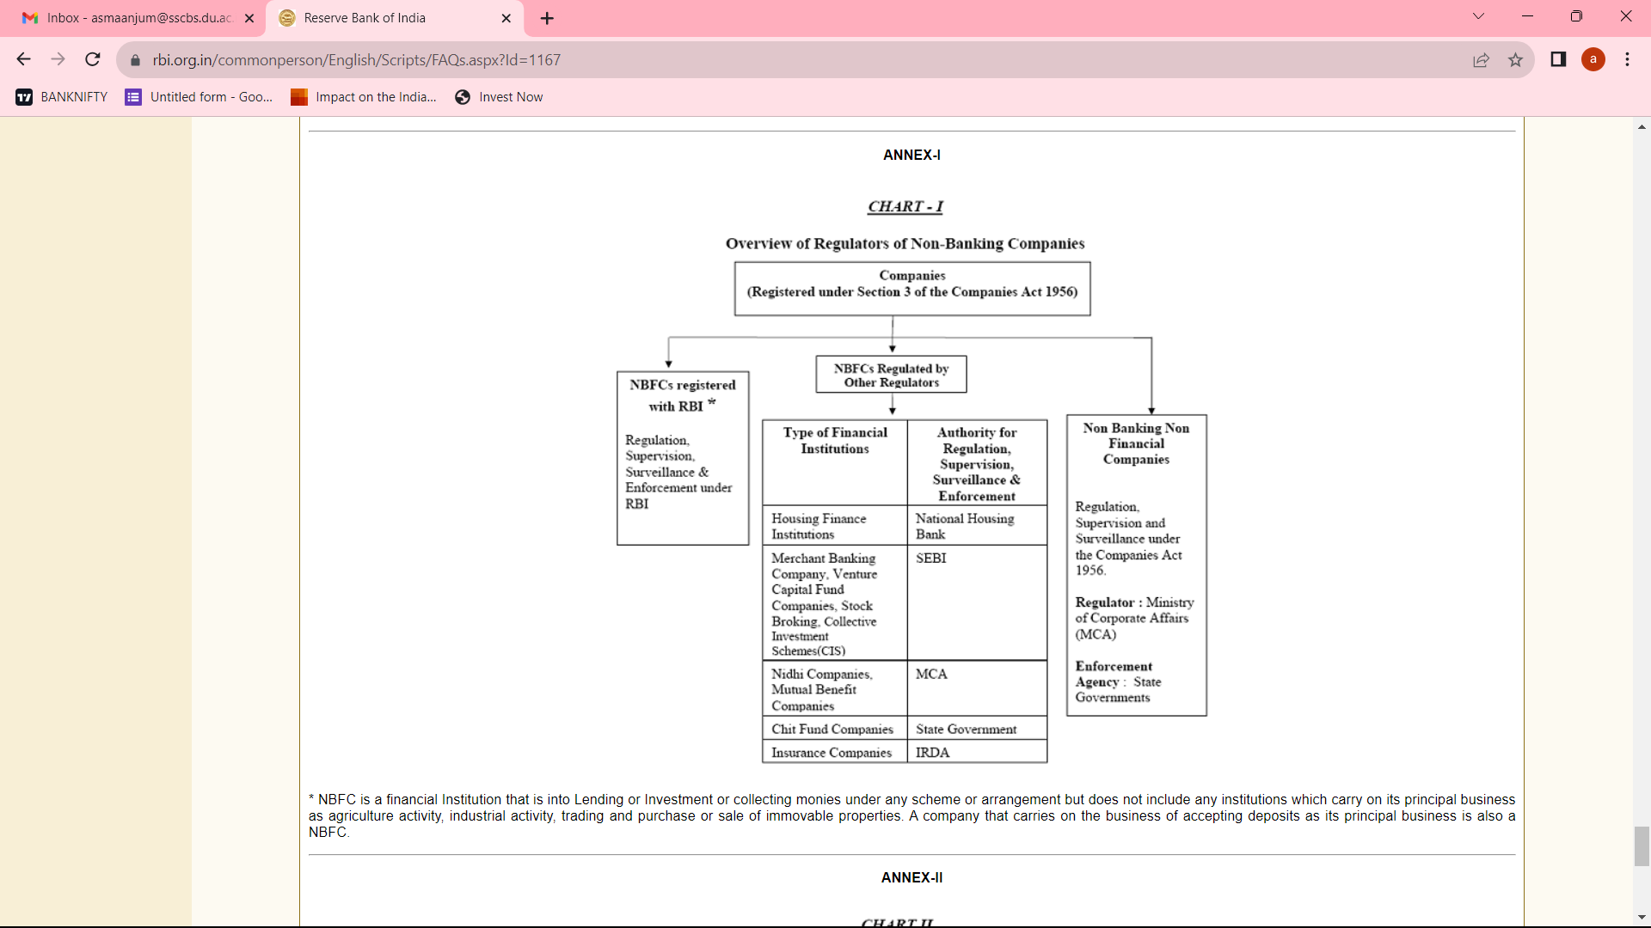
Non-Depository Institutions

Slide 50
Non Banking Financial Institutions
Nonbank financial companies (NBFCs), also known as nonbank financial institutions (NBFIs) are entities that provide certain bank-like and financial services but do not hold a banking license.
NBFCs are not subject to the banking regulations and oversight by federal and state authorities adhered to by traditional banks.
Investment banks, mortgage lenders, money market funds, insurance companies, hedge funds, private equity funds, and P2P lenders are all examples of NBFCs.
Since the Great Recession, NBFCs have proliferated in number and type, playing a key role in meeting the credit demand unmet by traditional banks.
Examples of NBFCs include investment banks, mortgage lenders, money market funds, insurance companies, hedge funds, private equity funds, and P2P lenders
For more details: https://www.rbi.org.in/commonperson/English/Scripts/FAQs.aspx?Id=1167

Slide 51
NBFC registered under RBI
When a company’s financial assets constitute more than 50 per cent of the total assets and income from financial assets constitute more than 50 per cent of the gross income. A company which fulfils both these criteria will be registered as NBFC by RBI.
A company incorporated under the Companies Act, 1956 and desirous of commencing business of non-banking financial institution as defined under Section 45 I(a) of the RBI Act, 1934 should comply with the following
It should be a company registered under Section 3 of the companies Act, 1956
It should have a minimum net owned fund of Rs. 200 lakh. (The minimum net owned fund (NOF) required for specialized NBFCs like NBFC-MFIs, NBFC-Factors, CICs is indicated separately in the FAQs on specialized NBFCs)
NBFCs whose asset size is of Rs. 500 Cr or more as per last audited balance sheet are considered as systematically important NBFCs.

Slide 52
Types of NBFC
Insurance companies: These companies sell insurance policies to individuals and businesses. The policies can provide coverage for things like car accidents, medical expenses, or property damage.
Investment banks: These banks help companies raise money by issuing and selling securities. They also provide advice on mergers and acquisitions, and they trade stocks and bonds.
Pension funds: These funds provide retirement income for workers. The money is invested in stocks, bonds, and other assets.
Mutual funds: These funds pool money from investors and invest it in a portfolio of stocks, bonds, and other assets.
Hedge funds: These funds are private investment partnerships that use a variety of investment strategies to make money.
Private equity firms: These firms invest in private companies and help them grow. They may also take the companies public.
Venture capital firms: These firms invest in early-stage companies with high growth potential.

Slide 53
Categories of NBFC
Asset Finance Company (AFC) : An AFC is a company which is a financial institution carrying on as its principal business the financing of physical assets supporting productive/economic activity. Principal business for this purpose is defined as aggregate of financing real/physical assets supporting economic activity and income arising therefrom is not less than 60% of its total assets and total income respectively.
Loan Company (LC): LC means any company which is a financial institution carrying on as its principal business the providing of finance whether by making loans or advances or otherwise for any activity other than its own but does not include an Asset Finance Company
Infrastructure Finance Company (IFC): IFC is a non-banking finance company a) which deploys at least 75 per cent of its total assets in infrastructure loans, b) has a minimum Net Owned Funds of Rs. 300 crore, c) has a minimum credit rating of ‘A ‘or equivalent d) and a CRAR of 15%.

Slide 54
Non-Banking Financial Company - Micro Finance Institution (NBFC-MFI): NBFC-MFI is a non-deposit taking NBFC having not less than 85% of its assets in the nature of qualifying assets which satisfy the following criteria:
Loan disbursed by an NBFC-MFI to a borrower with a rural household annual income not exceeding 1,00,000 or urban and semi-urban household income not exceeding 1,60,000;
Loan amount does not exceed 50,000 in the first cycle and 1,00,000 in subsequent cycles and repayable on weekly, fortnightly or monthly instalments at the choice
Total indebtedness of the borrower does not exceed 1,00,000;
Tenure of the loan not to be less than 24 months for loan amount in excess of 15,000 with prepayment without penalty;
Loan to be extended without collateral;
Aggregate amount of loans, given for income generation, is not less than 50 per cent of the total loans given by the MFIs;
Investment Company (IC) : IC means any company which is a financial institution carrying on as its principal business the acquisition of securities,

Slide 55
Systemically Important Core Investment Company (CIC-ND-SI): CIC-ND-SI is an NBFC carrying on the business of acquisition of shares and securities which satisfies the following conditions:-
It holds not less than 90% of its Total Assets in the form of investment in shares n debentures.
Its investments in the equity shares (including instruments compulsorily convertible into equity shares within a period not exceeding 10 years from the date of issue) in group companies constitutes not less than 60% of its Total Assets;
It does not trade in its investments in shares, debt or loans in group companies except through block sale for the purpose of dilution or disinvestment;
It does not carry on any other financial activity referred to in Section 45I(c) and 45I(f) of the RBI act, 1934 except investment in bank deposits, money market instruments, government securities, loans to and investments in debt issuances of group companies or guarantees issued on behalf of group companies.
Its asset size is Rs.100 crore or above

Slide 56
Infrastructure Debt Fund: Non- Banking Financial Company (IDF-NBFC): IDF-NBFC is a company registered as NBFC to facilitate the flow of long term debt into infrastructure projects. IDF-NBFC raise resources through issue of Rupee or Dollar denominated bonds of minimum 5 year maturity. Only Infrastructure Finance Companies (IFC) can sponsor IDF-NBFCs.
Mortgage Guarantee Companies (MGC) - MGC are financial institutions for which at least 90% of the business turnover is mortgage guarantee business or at least 90% of the gross income is from mortgage guarantee business and net owned fund is Rs.100 crore
Non-Banking Financial Company – Factors (NBFC-Factors): NBFC-Factor is a non-deposit taking NBFC engaged in the principal business of factoring. The financial assets in the factoring business should constitute at least 50 percent of its total assets and its income derived from factoring business should not be less than 50 percent of its gross income.

Slide 57
NBFC- Non-Operative Financial Holding Company (NOFHC)- is financial institution through which promoter / promoter groups will be permitted to set up a new bank .It’s a wholly-owned Non-Operative Financial Holding Company (NOFHC) which will hold the bank as well as all other financial services companies regulated by RBI or other financial sector regulators, to the extent permissible under the applicable regulatory prescriptions.

Slide 58
Role of NBFC in Economic Development
Mobilization of Resources
Supplying of Long term Credit
Greater Employment opportunities and standard of living
Capital formation
Strengthening the financial market
Attracting foreign grants
Breaking the vicious cycle of poverty
Specialized credit
Growth of National Income

Slide 59
How do Non-banking financial institutions differ from Banking financial institution?
NBFCs are not regulated by the government like banks are. This means that they are not subject to the same laws and regulations.
NBFCs do not take deposits from customers. Instead, they raise money by selling securities or borrowing money.
NBFCs are not required to maintain a reserve ratio like banks are. This ratio is the percentage of deposits that a bank must keep in reserve in case of withdrawals.
NBFCs are not subject to the same capital requirements as banks. This means that they are not required to have a certain amount of money in the reserve to protect against losses.
NBFCs are not subject to the same lending restrictions as banks. This means that they can lend money to anyone they choose, without having to follow the government’s guidelines.
These differences between banks and non-banking financial institutions can make it easier for businesses to access funding.

Slide 60
Depository Institutions/ Banks | Non-depository Institutions/NBFCs
Accepts deposits | Not accepts time deposits instead charges fees
Requirement of minimum reserve | No such requirement
By lending the money they in saving of public | Do pool of money from the public in the form of premium n contributions
Risk free or least risky | Financial risk
Banking Act, RBI is regulatory body | IRDA, SEBI, PERDA, etc.
interest | Periodic benefit, payouts
Services are limited | Diversification of services provided

Slide 61
Financial Inclusion
Financial inclusion refers to efforts to make financial products and services accessible and affordable to all individuals and businesses, regardless of their personal net worth or company size.
Financial inclusion strives to remove the barriers that exclude people from participating in the financial sector and using these services to improve their lives.
The financial industry is continually coming up with new ways to provide products and services to the global population, and often turn a profit in the process.
Financial inclusion strengthens the availability of economic resources and builds the concept of savings among the poor.
Financial inclusion is a major step towards inclusive growth in the overall economic development of the underprivileged population.
It focuses on providing financial solutions.
The term is broadly used to describe the provision of savings and loan services to the poor in an inexpensive and easy-to-use form.
It aims to ensure that the poor and marginalized make the best use of their money and attain financial education.
In India, effective financial inclusion is needed for the uplift of the poor and disadvantaged people by providing them with the modified financial products and services.

Slide 62
Road of Financial Inclusion in India
Increased Access to Banks: According to the World Bank’s Global Financial Inclusion Database or Global Findex report (2017), 80% Indian adults have a bank account against the 53% estimated in 2014. The Findex 2017 report also estimates that 77% Indian women have bank accounts, against 43% in 2014.
Multiplier Effect: Initiatives have brought about major changes to increase the last-mile connectivity of financial services to its people. By providing access to financial resources to underprivileged and marginalised sections of society, financial inclusion has the potential to reduce poverty, create jobs, among others.
Enhancing Active Participation of Citizenry: Earlier, private institutions did not engage with the poor as customers on a significant scale. This has now changed, and there has been an active participation of the private players (payment banks like paytm, airtel money and jio money), as they have also realised that bringing the poor into the financial net is beneficial to their business models as well.
Integration of Financial Services: The convergence of JAM trinity with the Direct Benefit Transfer (DBT) scheme has largely been successful. Due to this, there has been a significant improvement in terms of targeted and accurate payments. It has also helped in weeding out duplication of entries, and bringing down the reliance on cash mode of payments.

Slide 63
Financial Intermediation
The financial intermediation process channels funds between third parties with a surplus and those with a lack of funds.
A financial intermediary does not only act as an agent for other institutional units, but places itself at risk by acquiring financial assets and incurring liabilities on its own account (for example banks, insurance corporations, investments funds).
Efficient intermediation by financial markets leads to higher economic growth by
increasing savings and their optimal allocation for productive uses.
It provide a convenient means to investors and borrowers, who are not financial experts but require to partake in a financial transaction.
The work of analysing and interpreting risk and reward for the investor.
It help lower the cost of financing due to the economies of scale and spread the risk between investors, providing a safer and more secure form of investment.

Slide 64
Thank
You

